Slide 1
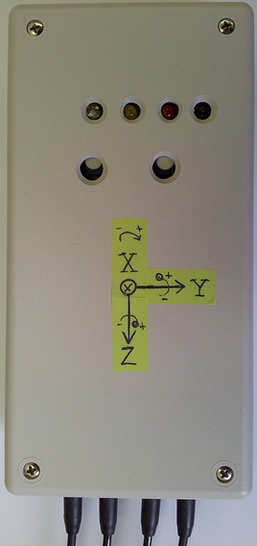

X
Y
Z

Slide 2

#5
#1
#7b
#4
Type 1: Individual
units.
#6
Type 2: Master + Slave
connected by a wire.
Type 3: Individual
coordination unit
#2
#3
#7a
Phone

